Slide 1
COURSE PROJECT
IN DISCIPLINE
APPLIED INFORMATICS
Prepared by:
Martin Sebahtin Hadzhiseid

Slide 2
Task text
1

Slide 3
Compile a program for processing the two-dimensional array A[N, N], where the data are integers in the interval [-10;10]. The program is to perform the following actions:
• print the condition of the task;
• print the names of the program author;
• enter the input data;
• print the input data;
• a) form a one-dimensional array C, the elements of which are the elements of the array A, whose squares are greater than 50
• b) sort the resulting array by size;
• printing of the obtained results after processing

Slide 4
Description of the used modules (and of how the program works)
2

Slide 5
This part of the code is responsible for printing out the elements of the two-dimensional array A.
This part of the code is implementing a bubble sort algorithm to sort the elements of the new array C in ascending order.
General description of how the program works
1
2
3
4
5
This part of the code uses nested loops to prompt the user to enter elements of a two-dimensional array A of size n x n.
This section of the code is responsible for creating a new array, C, and populating it with elements from the original array, A, whose squares are greater than 50.
This C program takes input from the user to create a 2D array, finds the elements whose squares are greater than 50 and forms a one-dimensional array C from those elements, and finally sorts C and prints it.

Slide 6
Listing of the source code of the program

Slide 7

#include<stdio.h>
#include <math.h>
const int k = 10;
int A[k][k], i, j, n, C[k];
int main()
{
printf("Author: Martin Hadzhiseid ");
printf("FNum: 371222001 ; Group: 90A \n");
printf("\n");
printf("Condition: Form a one-dimentional array C whose elements are the elements of the array A whose squares are greater than 50, and sort the resulting array by size\n");
printf("\n");
printf("Enter number of rows and columns in the array: n = ");
scanf_s("%d", &n);
printf("Enter elements of the array: \n");
for (i = 0; i < n; i++)
{
for (j = 0; j < n; j++)
{
do
{
printf("Enter number in A[%d][%d] = ", i, j);
scanf_s("%d", &A[i][j]);
} while (!((A[i][j] > -10) && (A[i][j] < 10)));
}
}

Slide 8
printf("\n");
printf("Your array: \n");
for (i = 0; i < n; i++)
{
for (j = 0; j < n; j++)
{
printf("%d ", A[i][j]);
}
printf("\n");
}
int count = 0;
for (i = 0; i < n; i++)
{
for (j = 0; j < n; j++)
{
if (pow(A[i][j], 2) > 50)
{
C[count] = A[i][j];
count++;
}
}
}
for (i = 0; i < count - 1; i++)
{
for (j = 0; j < count - i - 1; j++)
{
if (C[j] > C[j + 1])
{
int temp = C[j];
C[j] = C[j + 1];
C[j + 1] = temp;
}
}
}
printf("New array:\n");
for (i = 0; i < count; i++)
{
printf("%d ", C[i]);
}
}

Slide 9
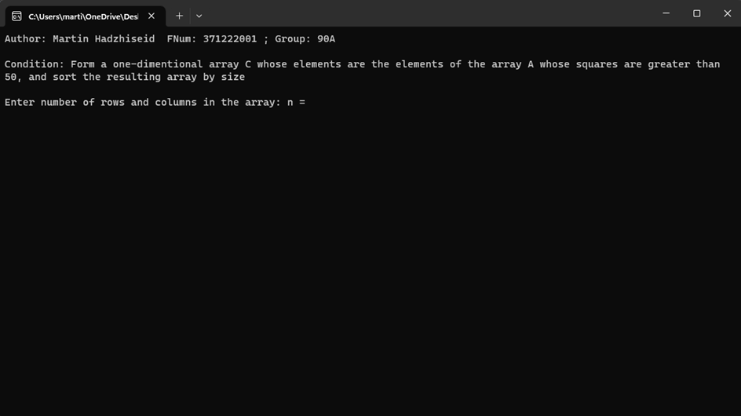
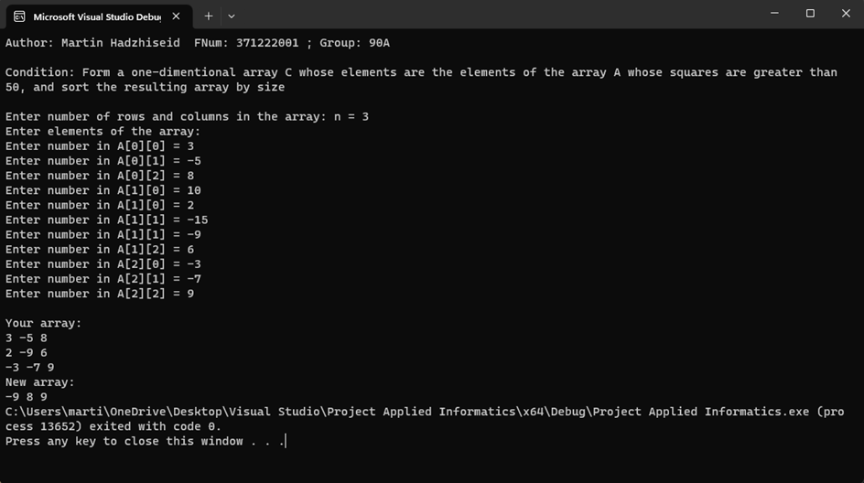
Results of program implementation

Slide 10
Thanks!

